Slide 1
Data Access Governance
Cognitive Enterprise Data Lake

Slide 2
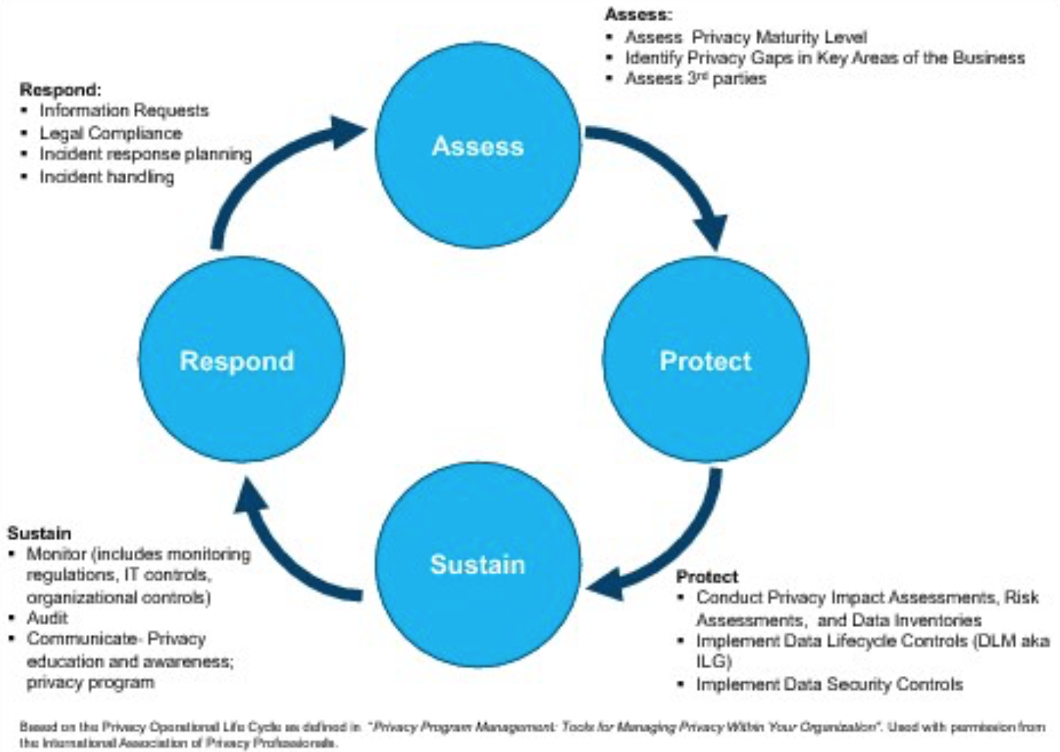
Data Security Operational Lifecycle
GPA
Acquisition process
Governance review
Monitoring
Breach policies
Cognitive audit
Access control
Denial of service protection
Transmission confidentiality and integrity
Cryptographic protection
Transmission of security attributes
Protection of information at rest
Source: NIST Special Publication 800-53

Slide 3
Access Control Epic Roadmap
Phase 3
Phase 2
Consent and access frameworks applied to governance framework
Monitoring of data in lake with respect to data access, data sensitivity and patterns
XaaS access framework established
Automation of manual process steps with oversight
Phase 1
Access control at the column level
Data access purpose based for outbound data in lake. Based on attributes of data in a column and the users purpose for the data
OneTEAM process for outbound switched to user purpose based access. May require new tool
Groupings of data including source tables, data spheres, views, and joins of data
Phase 0
Access control at the table level
Data access role based for outbound data in lake. Based on attributes of data in table
OneTEAM process for outbound switched to role based access
Automated classification of ingested and hosted data to identify sensitive data
Initial derived data controls in place
Initial monitoring in place
Access control at the source/schema level only
Data access 1:1 mapped between user and data source
OneTeam process to request access to a data source in the lake (inbound, outbound, and catalog). Data source in lake 1:1 mapped to drop zone
Manual access process for exception processing
Manual identification of sensitive attributes of ingested data

Slide 4
0.5 Access Control (Phase 0)
Access Controls and Policies

Slide 5
0.5 Access Governance Policy
GPA assessment must be completed on data sources that are to be accessed in the data lake
Data tagged if containing sensitive data
Users must be authorized before accessing data
Users must request access to each individual source outside of the CoEDL
Business justification for consumer to original source cannot state they need access to the CoEDL
Users cannot access sensitive data unless they have the credentials mentioned in previous bullet
First line managers must approve user access to CoEDL
CDO approve user access to CoEDL
Separation of Duties statement must exist for approvers
User must be part of a BlueGroup associated with a block of data.
No access allowed to restricted data during blackout dates for any user
Control systems must be used for DB access
SAML provides user authentication
BlueGroup form the basis of authorization policy in the data lake
Bluepages provide user authorization to BigSQL and HDFS.
DB policy driven by LDAP for user access
Geography and divisional access integrity can be maintained via dedicated schemas or by means of views.
Audit controls must be in place
OneTEAM logs for requests and approvals
Notifications of request activities sent to a dedicated channel for monitoring and audit
CEDP logs maintained for access
Data must be encrypted in flight
Data producers govern the access to their data in the lake
Revalidation and revocation of access to data managed by original source producers

Slide 6
0.5 Additional Statements
The GCDO Information Governance organization governs the CEDP infrastructure and [provide the means for data asset owners to regulate access to their respective data sets
This documents supports 0.5 with a minimal set of access requirements. Assumes:
Restricted and small set of users accessing the system inbound and outbound
Access is not granted all data in the data lake. Data must be approved for each source in the lake by the source.¹
If access is granted for a user to a data source within the lake, then that user gets access to ALL the data in that source
OneTEAM is the authoritative source for users and source access
1:1 map between inbound and outbound data sources at schema level
1 BlueGroup for each (inbound and outbound)
CEDP--- BlueGroup gives access to data lake only
An internal LDAP defines authorization for data within the lake. This is synchronized with source BlueGroups
Architecture and process review to be completed on entire system before release to assess adherence to policies
Notes: 1 – Exception: co-creators and dev have access to all the data in the CoEDL

Slide 7
Drop Zone (Inbound) Data Access Process
Governance Framework
Data
Sources
Process
Startup
OneTEAM³ setup
Source 1
Source n
Source identified¹
BlueGroups provided by the … created²
Producers identified⁴ and associated with BlueGroup
Inbound
Data Acquisition
Data Ingestion
Source DB created; LDAP synced with BlueGroup
Data pushed (encrypted) to drop zone (read only)
Data Integration
Data moved to production; drop zone deleted
Notifications sent via email & Slack {?}
Data Storage
User access⁵ to table(s) requested via OneTeam³
Approvals obtained
Producer mapped against BlueGroup in landing zone
Outbound
Notes: 1 – Does not include PI information from end user
2 – Single BlueGroup for each Data Sourceall inbound data
3 – Manual process in place as well where OneTEAM used
4 – First line management and CDO approval required
5 – Access granted at the source level
6 – Producer group to access their schemas. Different from consumer BlueGroups
Consumer use case
Drop Zone BlueGroup
Producer Landing Zone BlueGroup⁶

Slide 8
Drop Zone (Inbound) Access Request Flow
CEDP
New DB setup
Sync LDAP
User validated against LDAP and BG
OneTEAM
Request access to DB
DB exists?
Yes
Add user to BlueGroup
User added to BG
No
Notify admin
Request access to DB
Notify user of reject
User login to drop zone
User pushes data to drop zone
Author/User
Entry added into OneTEAM form
Notify CEDP
Admin
Approve
No
Manager
Yes
No
Approve
Yes
CDO Approver

Slide 9
Landing Zone (Outbound) Data Access Process
Governance Framework
Data
Sources
Process
User must already have access to original source DB, or must request it before applying for access
CEDP BlueGroup is created
Startup
Source 1
Source n
At acquisition time, producer identifies bluegroup(s) associated with data source
Existing users from source are added to CEDP BlueGroup
Inbound
Data Acquisition
Data Ingestion
Data Integration
Data Storage
User access¹ to CoEDL requested via OneTeam²
Approvals obtained³
User added to CEDP BlueGroup⁴
Periodic sync of users in source BlueGroup(s) to schema LDAPs in CEDP
Outbound
Consumer use case
Consumer BlueGroups for Data Source
Notes: 1 – Access granted at the source level. Must show they already have access to original data source
2 – Manual process in place as well where OneTEAM used
3 – First line mgmt and CDO approval required
4 – Single BlueGroup for all outbound data to allow into CoEDL, individual BlueGroup(s) for each data source in CEDP
Co-creator
Producer
Consumer
Dev
Consumer BlueGroup for CoEDL

Slide 10
Outbound Access Control Scenarios
New Consumer | Existing consumer, new source | Co-creator | CDO Developer | Derived Data (Producer)
Consumer requests and is granted access to the CEDP Consumer gets individual schema and HDFS folder Consumer requests and is granted access to the IGC (catalog) | Access to CEDP has already been granted to consumer based on previous scenario Consumer browses catalog and identifies new data source Consumer requests and is granted access to the data source outside of CoEDL Data producer adds consumer to appropriate Bluegroup Bluegroup is synced to associated schema in CoEDL Access to the new data is available to consumer | Co-creator signs DOU for access to the CoEDL Email request is sent to CDO Co-creator is added to the co-creator Bluegroup Co-creator schema and HDFS folder are created Access to all the data in the CoEDL is available to co-creator | Email request is sent to CDO Developer is added to the developer Bluegroup Developer schema and HDFS folder are created Access to all the data in the CoEDL is available to developer | Consumer has already requested and received access to CoEDL and data sources Consumer creates new data set by joining their data sources New data set exists in integration zone Access to new data in IZ driven by BCG for consumer now producer Consumer/producer can submit data back to acquisition process to create new data source Consumer/producer owns creating and managing Bluegroup for access to new source

Slide 11
Outbound Access Request Flow - CEDP
CEDP
BlueGroup synced to LDAP
OneTEAM
Request access to CoEDL
Add user to CEPD BlueGroup
User added to CEDP BG
User rejected
Author/User
Approve
No
Manager
Yes
No
Approve
Yes
CDO Approver

Slide 12
Outbound Access Request Flow – Data Source
CEDP
BlueGroup synced to LDAP
OneTEAM
Request access to Source
Add user to Source BlueGroup
User added to BG
User rejected
Consumer
Approve
No
Manager
Yes
No
Approve
Yes
Approver

Slide 13
Catalog Data Access Process
Governance Framework
Data
Sources
Process
Startup
3 BlueGroups existing¹
OneTEAM² setup
General
Author
Admin
Inbound
Data Acquisition
Data Ingestion
Data Integration
Data Storage
Catalog
User access to table(s) requested via OneTeam²
Approvals obtained
User mapped against BlueGroup(s)
Outbound
Consumer use case
Catalog BlueGroups
Notes: 1 – General access, admin and author access BlueGroups
2 – Read only no approval, author must be approved. Manual process in place for admin accounts

Slide 14
Catalog Access Request Flow¹
CEDP
BlueGroup synced to LDAP
OneTEAM
Request access to DB
Author access?
No
Add user to CEPD BlueGroup
Yes
User rejected
Author/User
Admin
Approve
No
Manager
Yes
No
Approve
Yes
Notes: 1 – Admin access only done manually
CDO Approver

Slide 15
Data Access Control System View
SAML
Admin validated against LDAP to push data or manage catalog
Sign on authentication associated with BlueGroup
Activity notifications sent to channel
CEDP
Slack
BlueGroups
Users in BlueGroups
Producer
Sync Script
First line mgmt approval required
User associated with a BlueGroup
BlueGroup members synced into CEDP schemas
IBM
OneTEAM
Catalog
Exists
Approved access request sent to CEDP
Query request to OneTEAM for user IW access list
In process
OneTEAM access info store
LDAP
Drop Zone
Manager
CDO approval required
CEDP
User requests access with biz justification and access credentials
DB2
Exists
Prod
Doesn’t Exist
CDO Approver
Consumer
User validated against LDAP to access data or catalog for viewing/query/reports

Slide 16
Access Control - BlueGroups
Access to all data
Access to CEDP only
Producer managed access to their data in drop zone
Producer managed access to their data in landing zone
Co-creator
DZ BG
LZ BG
Dev
CEDP
Legend
LZ
Data Source
DZ
LDAP Sync
LDAP Sync
BigSQL
Producer managed
V1
JDBC
V2
Producer
Log
HDFS
IZ
ES
GCDO managed
WebHDFS
Form
DB/DS Name
I/BG Name
O/BG Name
Catalog
Author
OneTEAM
LDAP Sync
Read
Catalog BlueGroups
Admin
Used by consumers and producers to request access
Consumer

Slide 17
Co-Creator (Outbound) Data Access Process
Governance Framework
Data
Sources
Process
Co-creator project identifies source data sets and gets agreement to be proxy to give access to data
Co-creator project BlueGroup is created. Co-creator project admin identified
Startup
Source 1
Source n
Inbound
Data Acquisition
Data Ingestion
Data Integration
Data Storage
User access¹ to Co-creator project requested via OneTeam
Approvals obtained²
User added to CEDP BlueGroup³
Periodic sync of users in source BlueGroup(s) to schema LDAPs in CEDP
Outbound
Co-creator BlueGroups for Data Sources
Co-creator
Notes: 1 – Access granted at the source level for each data set
2 – First line mgmt, Co-creator project admin, and CDO approval required
3 – Single BlueGroup for all outbound data to allow into CoEDL, co-creator identified BlueGroup for access to each data source in project in CEDP
Consumer use case

Slide 18
Co-creator Access Request Flow
BlueGroup synced to LDAP for all source identified in co-creator project
CEDP
OneTEAM
Request access to Source
Add user to C0-creator BlueGroup
User added to BG
User rejected
Consumer
Approve
No
Manager
Yes
Approve
No
Co-Creator admin
Yes
No
Approve
Yes
CDO Approver

Slide 19
Co-Creator Access Control
Access to Co-creator identified data sets
Access to CEDP only
Co-Creator
CEDP
Co-Creator admin
LZ
Data Source
DZ
LDAP Sync
BigSQL
JDBC
Producer
Log
HDFS
IZ
ES
WebHDFS
Catalog
Author
OneTEAM
LDAP Sync
Read
Catalog BlueGroups
Admin
Used by consumers and producers to request access
Co-Creator

Slide 20
Backup
Access Controls and Policies

Slide 21
Security Compliance Requirements
4.2 User Access Management
Access to systems, applications or information, whether granting or revoking, is a two-step process:
An identity token (user ID) is assigned to a user, enabled, and ultimately disabled and/or revoked.
Access rights are then assigned to, or revoked from, that user ID.
4.2.1 User Identities
Leverage centralized identity services, such as w3id or IBMid for applications.
Assign unique IDs to a single individual to ensure individual accountability.
Disable or remove User IDs upon separation of an employee, or at the end of a contractor engagement. Block or disable access to non-public IT systems within 24 hours.
Discard User IDs that are no longer in use. Do not reissue previously assigned User IDs to other users.
Provide a means to allow operating units to disable or remove User IDs immediately in case of an emergency.
4.2.2 Application or System Identities
Assign Application or System IDs, by default, to the owner of the application or the system, or otherwise assign to an authorized individual. The owner of the Application or System ID is accountable for its use. Application or System IDs may be transferred to a new owner when the original owner's employment or business need ends.
Disable or remove Application or System IDs that are no longer needed.
Change default vendor passwords immediately following installation of systems or software.

Slide 22
Security Compliance Requirements, Cont’d
4.2.3 Access Provisioning
Assign access rights on a business need or need-to-know basis.
Implement an authorization process for applications and systems if and as required by the BPO, or as required by the data or asset classification (section 2.0).
Complete authorization procedures prior to enabling access rights.
4.2.4 Managing Privileged Access Rights
Assign privileged access carefully and with the least amount of privilege required. Mitigate inappropriate use of privileged access rights, to prevent data breaches or failures.
Assign privileged access rights to users on a need-to-know basis, and based on the minimum requirements for the role.
Maintain an authorization process and record for assigning privileged access. Complete authorization procedures prior to enabling access rights.
Develop and implement procedures to avoid unauthorized use of generic administrative user IDs.
Limit privileged access to scripts or other executable utility programs to authorized users. Log and monitor the use of these tools.
Identify and track privileged access rights associated with each system or device that the privileged user oversees.
Maintain the confidentiality of secret authentication information for generic administrative user IDs (e.g. change passwords frequently and as soon as possible when a privileged user leaves or changes job, communicate them among privileged users with appropriate mechanisms).

Slide 23
Security Compliance Requirements, Cont’d
4.2.5 Review of Access Rights
Implement a re-authorization process for applications and systems if and as required by the BPO, or as required by the data or asset classification (section 2.0).
Base re-authorization processes on defined milestones or defined time intervals, depending on the authorities or roles associated with the access or on regulatory or legal requirements. Milestones may include changes to the job role of an individual with access, or changes to the application or system that warrant a review of existing access rights.
Limit time-interval based re-authorization to a maximum of 12 months.
Review privileged access rights for continued business needs at least every 12 months.
4.2.6 Revocation of Access Rights
Remove access rights when there is no longer a business need for the employee or contractor to have the access.
Block or remove access within 24 hours of termination of employment for an IBM employee or contractor. Where IBM does not control access, notify the entity controlling access within 24 hours.
Provide a means to allow operating units to block or remove access immediately in case of an emergency.

Slide 24
Phase 3
Phase 2
Consent and access frameworks
Monitoring of data in lake with respect to data access, data sensitivity and patterns
XaaS access framework established
Automation of approval process steps with oversight
Phase 1
Advanced access control –Data access role and purpose based
OneTEAM process for outbound switched to user purpose based access
Groupings of data including source tables, data spheres, views, and joins of data
Phase 0
Access control at the schema level
Data access 1:1 mapped between user and data source
Data owners responsible for managing their data
OneTeam used for access control management
Access control at the table, column, row level
Derived data controls in place
Self-service access management tools for producers
Initial monitoring in place

